Slide 1
The Life of an SWE
<Hetav Pandya/>

Slide 2
Introduction
{
"Name" : "Hetav Pandya",
"Program" : "Computer Engineering",
"Year" : [ "2T3", "PEY"],
"Institution" : "University of Toronto",
"Experience" : "Intel Corporation, Bell, General Motors"
}

Slide 3
Agenda
{
“ItemsForToday" : [
“Peek into a day of a SWE”,
“Project planning in industry”,
“How to establish a career in the tech industry?”,
“How can University education help in the process?”]
}
Notes:
Opengrok
Version control
Design patterns
Technical documentation
Ownership
Attitude
Know your industry

Slide 4
Peek into the life of a Software Engineer
There are primarily two types of task you work on a day-to-day basis

Slide 5
Peek into the life of a Software Engineer
Not Urgent
&
Important
Urgent
&
Important
Small bugs that are reported by Quality Assurance team
Not Urgent
&
Not Important
Urgent
&
Not Important
Eisenhower matrix

Slide 6
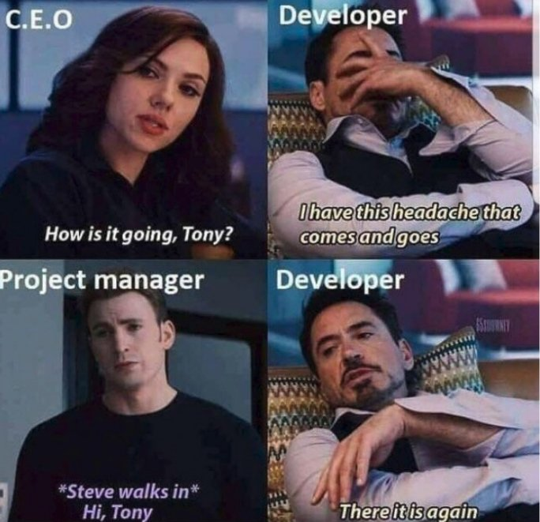
Peek into the life of a Software Engineer
Major projects that have been assigned to you.

Slide 7

66%
Of all technological projects fail partially or completely.
90%
Of all major technological projects fail.

Slide 8
Prepare a draft problem statement highlighting the existing issue.

Slide 9
Have data to back up that the problem you are solving actually exists.

Slide 10
Identify the stakeholders or people who will be affected by the project.

Slide 11
Come up with different ideas to solve the problem.

Slide 12
Sit down with a more experienced colleague to go over your solution ideas.

Slide 13
Set up a meeting with the stakeholders to identify the best solution.

Slide 14
How to establish a career in the tech industry?
Tech Industry
You have a destination, now all you need is a direction.

Slide 15
How to establish a career in the tech industry?
University
Internships
College
Projects
Full-time SWE
Freelancing
Independent Contractor
Self-Learning
OpenSource

Slide 16
Time
University
College (Diploma)
Monetary Investment
Freelancing
OpenSource

Slide 17
Initial Pay
University
College (Diploma)
Certainty
Freelancing
OpenSource

Slide 18
Growth Potential
University
OpenSource
College (Diploma)
Freelancing
Difficulty

Slide 19






Take time to talk to people who have chosen different routes.

Slide 20
The best route if a hybrid one: Formal + Informal education

Slide 21
How can University and College help in your journey?
Gives you a structured education plan.

Slide 22
How can University and College help in your journey?
It’s a treasure trove of opportunities: Good Professors, Great Research, Good Internship Programs

Slide 23
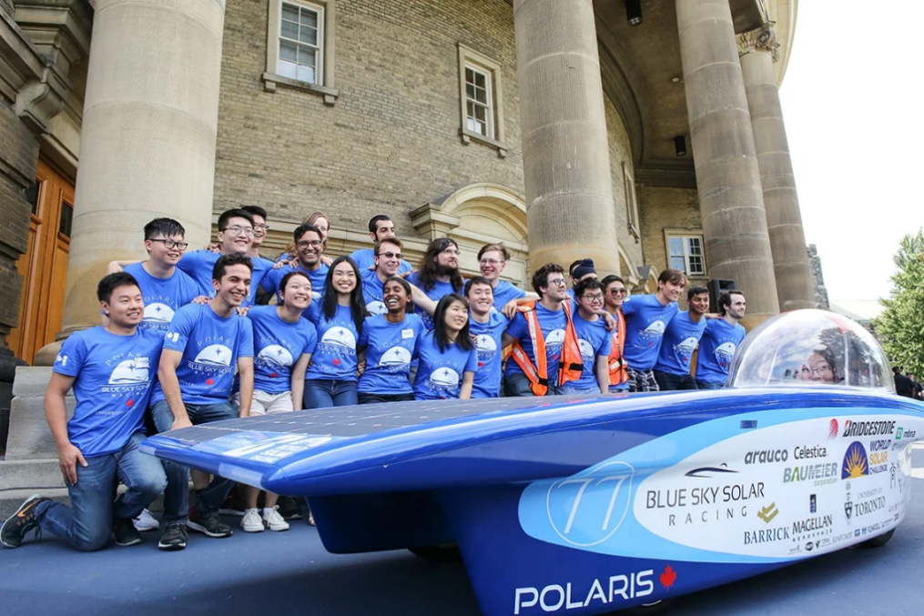
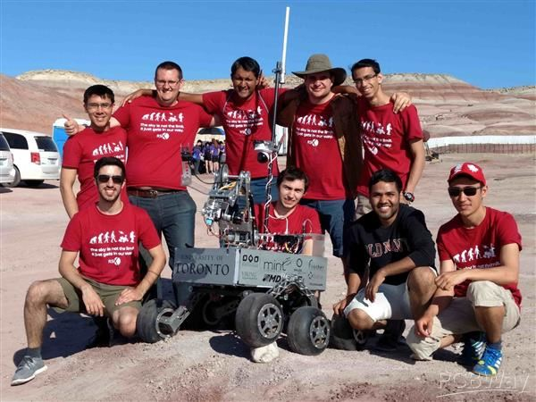

How can University and College help in your journey?
Specialized student clubs - Machine Learning, PCB chip design, Robotics, Guitar etc.

Slide 24

How can University and College help in your journey?
Combining different majors:
- Biotechnology with CS
- Climate specialization with CS
- Cognitive science and CS
- Math and CS
- Finance and CS

Slide 25
How can University help in your journey?
Projects
LeetCoding
Internships
You still have to go beyond your courses…
Research
Hackathons

Slide 26
Thank you!

Slide 27
(If time permits)

Slide 28

How to write maintainable code?
The subtle art of not messing it up.
Notes:
Opengrok
Version control
Design patterns
Technical documentation
Ownership
Attitude
Know your industry

Slide 29
Learn what unit tests are and how different languages support it.
There are methods to automate testing using scripting languages like bash, Perl etc.
Python has a module called unittest dedicated to testing.
Testcases before code.
It makes you consider extreme scenarios of your use case at the very beginning.
It provides a quantitative method to measure progress.
Notes:
E.g. python has a unittest module

Slide 30
C++ has the standard template libraries. Give it a thorough read!
Python is known for its rich module support for variety of tasks ranging from Finance to AI.
Do not reinvent the wheel.
Consider using pre-created functionalities.
It saves time and helps build secure software.

Slide 31

To learn design patterns you can read the book: “Design Patterns: Elements of Reusable Object-Oriented Software”
Learn how and where to use design patterns.
Design patterns can help you write reusable code that is scalable in the future.
These patterns have been tried and tested by thousands of developers.

Slide 32
Products like Doxygen helps you automatically generate documentation from comments in the code.
Products like GitBook help you manage multiple people working on documentation.
Document the code as you write it.
Don’t make self-explanatory remarks. Instead explain what the code is intending to do on a high level.
Stop manually documenting code, instead use some automation tools.

Slide 33
Learn how to generate flamegraphs for CPU usage. They help spot bottlenecks in code.
Tools like valgrind can help you check memory usage and identify any memory leaks in your code.
Learn how to check the performance of your code.
Learn to use performance tools that help you check CPU time of your code. It will help you build faster code.
Learn to use tools to check the memory usage of your code.

Slide 34
Git is one of the most popular version control systems. It is highly advised to have an account on GitHub and play around with it.
Having a well polished GitHub profile will boost your chances in the recruitment process.
Learn to use version control tools.
You must know how to efficiently use your company’s version control software.
Knowing how to navigate your version control system can streamline your coding process.

